Slide 1
Autonomous Agricultural Monitoring System
Submitted in the partial fulfillment for the award of the degree of
BACHELOR OF ENGINEERING
IN
COMPUTER SCIENCE WITH SPECIALIZATION IN AIML
Submitted by:
Hardik 20bcs6260, Sachin 21bcs6025,
Shivangi 21bcs6155
Under the Supervision of:
Ms. Tanvi (E15506)
Department of AIT-CSE
DISCOVER . LEARN . EMPOWER

Slide 2
Table of content
Introduction to Project
Problem Formulation
Objectives of the work
Methodology used
Results and Outputs
Conclusion
Future Scope
References

Slide 3
Introduction
In the ever-evolving landscape of agriculture, the need for efficient, precise, and sustainable monitoring systems has become increasingly paramount. Autonomous Agriculture Monitoring System represents a paradigm shift in agricultural monitoring, harnessing cutting-edge technologies such as artificial intelligence, satellite imagery, drones, and IoT sensors to provide real-time insights into crop health, soil conditions, pest infestations, and more. By seamlessly integrating these technologies, AAMS empowers farmers with comprehensive data-driven decision-making tools, enabling them to optimize yields, minimize resource usage, and mitigate risks effectively.
One of the key features of AAMS is its autonomy. Gone are the days of manual field inspections and guesswork. With AAMS, monitoring becomes automated, allowing for continuous, round-the-clock observation of agricultural operations. Drones equipped with high-resolution cameras patrol the fields, capturing detailed images that are analyzed in real-time by AI algorithms. These algorithms detect anomalies, identify potential issues, and provide actionable insights to farmers instantly, facilitating proactive intervention and preventing crop losses.

Slide 4
Problem Formulation
Agriculture is vital for global food security and sustainable development. However, traditional agricultural monitoring methods are often labor-intensive, time-consuming, and prone to inaccuracies.
The problem arises from the limitations of conventional approaches in providing real-time, comprehensive, and precise data for effective decision-making in farming practices.
Challenges with Traditional Methods:
Labor Intensive: Manual monitoring techniques, such as visual inspections and periodic sampling, require significant labor and resources, making them impractical for large-scale or remote agricultural areas.
Limited Precision: Traditional methods may fail to capture fine-scale variations in soil conditions, crop health, and environmental factors, leading to suboptimal management decisions.
Time Consuming: Delays in data collection, analysis, and dissemination hinder timely interventions, increasing the risk of crop losses and reduced yields.
Inefficient Resource Management: Without accurate and timely information on soil moisture, nutrient levels, and pest infestations, farmers may struggle to optimize resource usage, leading to environmental degradation and economic losses.

Slide 5
OBJECTIVES
1.Enhance Crop Management
2.Optimize Resource Utilization
3.Improve Yield Prediction
4.Early Detection of Anomalies
5.Facilitate Precision Agriculture
6.Enhance Environmental Sustainability
7.Increase Operational Efficiency
8.Enhance Data-driven Decision Making
9.Enable Remote Monitoring and Management

Slide 6
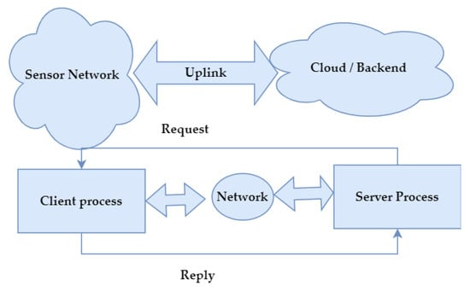
Methodology
Proposed IoT Client-Server Model.

Slide 7
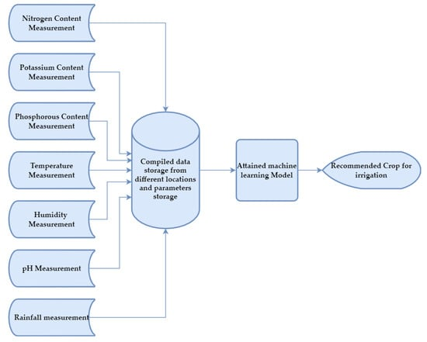
Fig . Block diagram using Machine learning Module.

Slide 8
Conclusion
In conclusion, IOT-enabled agriculture system is greatly beneficial to the farmers as it reduces the manpower and harmful chemicals fori ncreasing the amount of the crops. Proper design is necessary for the farming with the reduces complexities. All the data should be properly taking into count for the better agriculture. The sensor placement and the connectivity are a vital step. The data redundancy should not be there in order to meet the accurate results. The farmer should be skilled with some experience or prior knowledge otherwise it would take much time to switch him to the traditional form of the okkfarming.Nevertheless, the work herein represents a working prototype of a real system. For commercialization, some enhancement need to be considered. First, the use of camera with machine learning can improve detection accuracy of intruder without the help of farmer.

Slide 9
Future Scope
Precision Agriculture Integration: AAMS can integrate with precision agriculture techniques to optimize resource usage such as water, fertilizers, and pesticides.
Environmental Monitoring and Sustainability: AAMS can play a crucial role in monitoring environmental parameters such as soil erosion, water quality, and carbon sequestration.
Autonomous Machinery Integration: AAMS can be integrated with autonomous agricultural machinery such as robotic tractors, drones, and harvesters.

Slide 10
References
Ray, P.P. Internet of Things for smart agriculture: Technologies practices and future direction. J. Ambient. Intell. Smart Environ. 2017, 9, 395–420.
Kamienski, C.; Soininen, J.-P.; Taumberger, M.; Dantas, R.; Toscano, A.; Salmon Cinotti, T.; Filev Maia, R.; Torre Neto, A. Smart Water Management Platform: IoT-Based Precision Irrigation for Agriculture. Sensors 2019, 19, 276.
Ojha, T.; Misra, S.; Raghuwanshi, N.S. Wireless sensor networks for agriculture: The state-of-the-art in practice and future challenges. Comput. Electron. Agric. 2015, 118, 66–84.
Vijayan, T.; Sangeetha, M.; Kumaravel, A.; Karthik, B. Feature selection for Simple Color Histogram Filter based on Retinal Fundus Images for Diabetic Retinopathy recognition. IETE J. Res. 2020.
Lavanya, G.; Rani, C.; GaneshKumar, P. An automated low cost IoT based Fertilizer Intimation System for smart agriculture. Sustain. Comput. Inform. Syst. 2020, 28, 100300.
Sivakumar, M.; Renuka, P.; Chitra, P.; Karthikeyan, S. IoT incorporated deep learning model combined with SmartBin technology for real-time solid waste management. Comput. Intell. 2021.

